Slide 1
Principles of Compiler Design
Chapter 8 Code Generation and Optimization

Slide 2
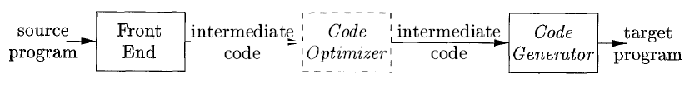
Code Generation
The final phase of the compiler model is the code generator.
It takes as input the intermediate representation (IR) produced by the front end of the compiler, along with relevant symbol table information, and produces as output a semantically equivalent target program
A code generator has three primary tasks: instruction selection, register allocation and assignment, and instruction ordering.
Instruction selection involves choosing appropriate target-machine instructions to implement the IR statements.
Register allocation and assignment involves deciding what values to keep in which registers.
Instruction ordering involves deciding in what order to schedule the execution of instructions.

Slide 3
Issues in the Design of Code Generator
The most important criterion is that it produces correct code.
Input to the code generator
IR + Symbol table
We assume front end produces low-level IR, i.e. values of names in it can be directly manipulated by the machine instructions.
Syntactic and semantic errors have been already detected.
The target program
Common target architectures are:
RISC(Reduced Instruction Set Computer),
CISC(complex instruction set computer) and
Stack based machines

Slide 4
Contd…
A RISC machine typically has many registers, three-address instructions, simple addressing modes, and a relatively simple instruction-set architecture.
In contrast, a ClSC machine typically has few registers, two-address instructions, a variety of addressing modes , several register classes, variable-length instructions, and instructions with side effects.
In a stack-based machine, operations are done by pushing operands onto a stack and then performing the operations on the operands at the top of the stack.
To achieve high performance the top of the stack is typically kept in registers.
Stack-based machines almost disappeared because it was felt that the stack organization was too limiting and required too many swap and copy operations.
In this chapter we use a very simple RISC-like computer with addition of some CISC-like addressing modes.

Slide 5

Instruction selection
The code generator must map the lR program into a code sequence that can be executed by the target machine.
The complexity of performing this mapping is determined by a factors such as
the level of the IR
the nature of the instruction-set architecture
the desired quality of the generated code.
For example, every three-address statement of the form x = y + z, where x, y, and z are statically allocated, can be translated into the code sequence

Slide 6

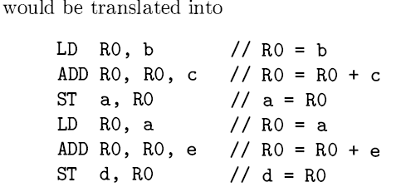
Contd…
This strategy often produces redundant loads and stores. For example, the sequence of three-address statements
Here, the fourth statement is redundant since it loads a value that has just been stored, and so is the third if a is not subsequently used.
The quality of the generated code is usually determined by its speed and size.

Slide 7
Register Allocation
A key problem in code generation is deciding what values to hold in what registers.
Registers are the fastest computational unit on the target machine, but we usually do not have enough of them to hold all values. Values not held in registers need to reside in memory.
Instructions involving register operands are invariably shorter and faster than those involving operands in memory, so efficient utilization of registers is particularly important.
The use of registers is often subdivided into two sub problems:
Register allocation, during which we select the set of variables that will reside in registers at each point in the program.
Register assignment, during which we pick the specific register that a variable will reside in.
Finding an optimal assignment of registers to variables is difficult, even with single-register machines.

Slide 8
Contd…
The problem is further complicated because the hardware and/or the operating system of the target machine may require that certain register-usage conventions be observed.
Example: Certain machines require register-pairs (an even and next odd numbered register) for some operands and results. For example, on some machines, integer multiplication and integer division involve register pairs.
The multiplication instruction is of the form M x, y
where x, the multiplicand, is the even register of an even/odd register pair and y, the multiplier, is the odd register. The product occupies the entire even/odd register pair.
The division instruction is of the form D x, y
where the dividend occupies an even/odd register pair whose even register is X; the divisor is y. After division, the even register holds the remainder and the odd register the quotient

Slide 9
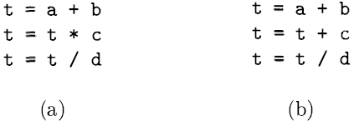
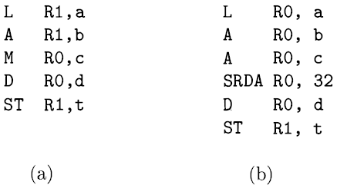
Contd…
Consider the two three-address code sequences in which the only difference in (a) and (b) is the operator in the second statement.
The shortest assembly-code sequences for (a) and (b) are given as

Slide 10
A Simple Target Machine Model
Our target computer models a three-address machine with load and store operations, computation operations, jump operations, and conditional jumps.
We assume the following kinds of instructions are available:
Load operations:
LD dst, addr loads the value in location addr into location dst.
LD r, x which loads the value in location x into register r.
LD r1 , r2 is a register-to-register copy in which the contents of register r2 are copied into register r1 .
Store operations: S1 x, r stores the value in register r into the location x.
Computation operations: OP dst, srcl , src2 , where OP is a operator like ADD or SUB, and dst, srcl , and src2 are locations, not necessarily distinct.
Unconditional jumps: BR L causes control to branch to the machine instruction with label L. (BR stands for branch.)
Conditional jumps: Bcond r, L, where r is a register, L is a label, and cond stands for any of the common tests on values in the register r.

Slide 11
Contd…
We assume our target machine has a variety of addressing modes:
In instructions, a location can be a variable name x referring to the memory location that is reserved for x.
A location can also be an indexed address of the form a (r), where a is a variable and r is a register.
The memory location denoted by a(r) is computed by taking the l-value of a and adding to it the value in register r.
For example, the instruction LD Rl , a (R2 ) has the effect of setting Rl = contents ( a + contents (R2) ) , where contents(x) denotes the contents of the register or memory location represented by x.
This addressing mode is useful for accessing arrays, where a is the base address of the array (that is, the address of the first element), and r holds the number of bytes past that address we wish to go to reach one of the elements of array a.

Slide 12
Contd…
A memory location can be an integer indexed by a register.
For example, LD Rl , 100 (R2 ) has the effect of setting R l = contents (100 + contents (R2) ) , that is, of loading into R l the value in the memory location obtained by adding 100 to the contents of register R2.
We also allow two indirect addressing modes: *r means the memory location found in the location represented by the contents of register r and * 100 (r) means the memory location found in the location obtained by adding 100 to the contents of r.
For example, LD Rl , * 100 (R2) has the effect of setting Rl = contents (contents (100 + contents (R2) ) ) , that is, of loading into Rl the value in the memory location stored in the memory location obtained by adding 100 to the contents of register R2.
Finally, we allow an immediate constant addressing mode. The constant is prefixed by #. The instruction LD Rl , # 100 loads the integer 100 into register Rl , and ADD Rl , Rl , # 100 adds the integer 100 into register R1.

Slide 13
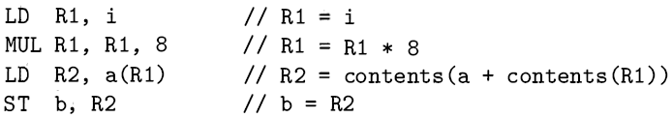
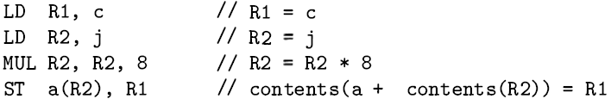
Contd…
Example1: We may execute the three-address instruction b = a [i] by the machine instructions(a is an array whose elements are 8-byte values) :
Example2: a [j ] = c is implemented by:

Slide 14

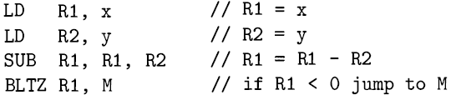
Contd…
Example3: To implement a simple pointer indirection, such as the three-address statement x = *p, we can use machine instructions like:
Example4: Consider a conditional-jump three-address instruction like if x < y goto L
The machine-code equivalent would be something like:

Slide 15
Basic Blocks and Flow Graphs
Partition the intermediate code into basic blocks, with the properties that
The flow of control can only enter the basic block through the first instruction in the block. That is, there are no jumps into the middle of the block.
Control will leave the block without halting or branching, except possibly at the last instruction in the block.
The basic blocks become the nodes of a flow graph, whose edges indicate which blocks can follow which other blocks.

Slide 16
Basic Blocks
We begin a new basic block with the first instruction and keep adding instructions until we meet either a jump, a conditional jump, or a label on the following instruction.
In the absence of jumps and labels, control proceeds sequentially from one instruction to the next.
This idea is formalized in the following algorithm.
Algorithm : Partitioning three-address instructions into basic blocks
INPUT: A sequence of three-address instructions.
OUTPUT: A list of the basic blocks for that sequence in which each instruction is assigned to exactly one basic block.

Slide 17
Contd…
METHOD: First, we determine those instructions in the intermediate code that are leaders, that is, the first instructions in some basic block. The instruction just past the end of the intermediate program is not included as a leader. The rules for finding leaders are:
1. The first three-address instruction in the intermediate code is a leader.
2. Any instruction that is the target of a conditional or unconditional jump is a leader.
3. Any instruction that immediately follows a conditional or unconditional jump is a leader.
Then, for each leader, its basic block consists of itself and all instructions up to but not including the next leader or the end of the intermediate program.

Slide 18
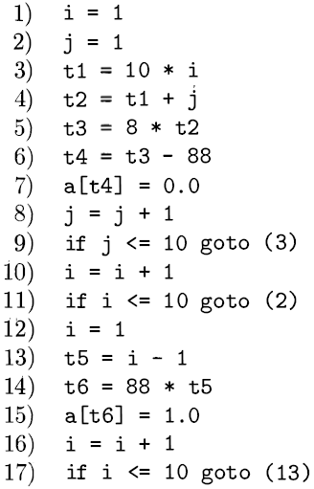
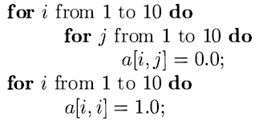
Contd..
Example: Intermediate code to set a 10 x 10 matrix to an identity matrix
First, instruction 1 is a leader by rule (1) of Algorithm.
To find the other leaders, we first need to find the jumps. In this example, there are three jumps, all conditional, at instructions 9, 11 , and 17.
By rule (2) , the targets of these jumps are leaders; they are instructions 3, 2, and 13, respectively.
Then, by rule (3) , each instruction following a jump is a leader; those are instructions 10 and 12. Note that no instruction follows 17 in this code, but if there were code following, the 18th instruction would also be a leader.

Slide 19
Next Use Information
Knowing when the value of a variable will be used next is essential for generating good code. If the value of a variable that is currently in a register will never be referenced subsequently, then that register can be assigned to another variable.
The use of a name in a three-address statement is defined as follows. Suppose three-address statement i assigns a value to x . If statement j has x as an operand, and control can flow from statement i to j along a path that has no intervening assignments to x, then we say statement j uses the value of x computed at statement i . We further say that x is live at statement i .
Algorithm: Determine the liveness and next-use information for each statement in a basic block.
INPUT: A basic block B of three-address statements. We assume that the symbol table initially shows all nontemporary variables in B as being live on exit.
OUTPUT: At each statement i : x = y + z in B, we attach to i the liveness and next-use information of x, y, and z.

Slide 20
Contd…
METHOD: We start at the last statement in B and scan backwards to the
beginning of B. At each statement i: x = y + z in B, we do the following:
Attach to statement i the information currently found in the symbol table regarding the next use and liveness of x , y, and y.
In the symbol table, set x to "not live" and "no next use.“
In the symbol table, set y and z to "live" and the next uses of y and z to i .
Here we have used + as a symbol representing any operator. If the three-address statement i is of the form x = + Y or x = y, the steps are the same as above, ignoring z. Note that the order of steps (2) and (3) may not be interchanged because x may be y or z.

Slide 21
Flow Graphs
Once an intermediate-code program is partitioned into basic blocks, we represent the flow of control between them by a flow graph.
The nodes of the flow graph are the basic blocks. There is an edge from block B to block C if and only if it is possible for the first instruction in block C to immediately follow the last instruction in block B .
There are two ways that such an edge could be justified:
There is a conditional or unconditional jump from the end of B to the beginning of C .
C immediately follows B in the original order of the three-address instructions, and B does not end in an unconditional jump.
We say that B is a predecessor of C , and C is a successor of B .

Slide 22
Contd…
Often we add two nodes, called the entry and exit, that do not correspond to executable intermediate instructions.
There is an edge from the entry to the first executable node of the flow graph, that is, to the basic block that comes from the first instruction of the intermediate code.
There is an edge to the exit from any basic block that contains an instruction that could be the last executed instruction of the program.
If the final instruction of the program is not an unconditional jump, then the block containing the final instruction of the program is one predecessor of the exit, but so is any basic block that has a jump to code that is not part of the program.

Slide 23
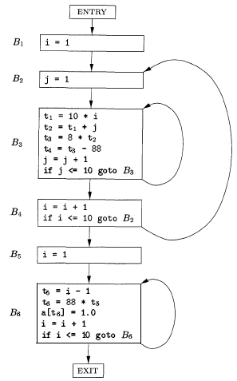
Contd…
Example: The set of basic blocks constructed in Example of slide10 yields the below flow graph. The entry points to basic block B1 , since Bl contains the first instruction of the program. The only successor of Bl is B2 , because Bl does not end in an unconditional jump, and the leader of B2 immediately follows the end of B1 .
Block B3 has two successors. One is itself, because the leader of B3 , instruction 3, is the target of the conditional jump at the end of B3 , instruction 9 . The other successor is B4 , because control can fall through the conditional jump at the end of B3 and next enter the leader of B4 .
Only B6 points to the exit of the flow graph, since the only way to get to code that follows the program from which we constructed the flow graph is to fall through the conditional jump that ends B6 .

Slide 24
DAG Representation of Flow Graphs
We construct a DAG for a basic block as follows:
There is a node in the DAG for each of the initial values of the variables appearing in the basic block.
There is a node N associated with each statement s within the block. The children of N are those nodes corresponding to statements that are the last definitions, prior to s, of the operands used by s.
Node N is labeled by the operator applied at s, and also attached to N is the list of variables for which it is the last definition within the block.
Certain nodes are designated output nodes. These are the nodes whose variables are live on exit from the block; that is, their values may be used later, in another block of the flow graph.

Slide 25
Contd…
The DAG representation of a basic block lets us perform several code improving transformations on the code represented by the block.
We can eliminate local common sub expressions, that is , instructions that compute a value that has already been computed.
We can eliminate dead code, that is , instructions that compute a value that is never used.
We can reorder statements that do not depend on one another; such reordering may reduce the time a temporary value needs to be preserved in a register.
We can apply algebraic laws to reorder operands of three-address instructions, and sometimes thereby simplify the computation.

Slide 26
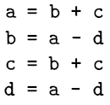
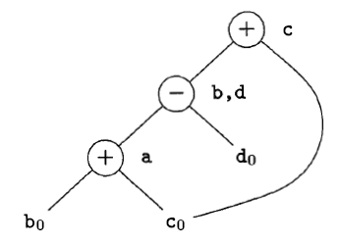
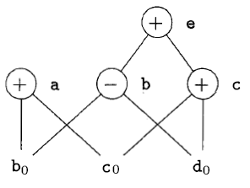
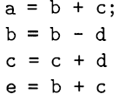
Contd…
Example: A DAG for the block

Slide 27
A Simple Code Generator
We consider an algorithm that generates code for a single basic block.
It considers each three-address instruction in turn, and keeps track of what values are in what registers so it can avoid generating unnecessary loads and stores.
One of the primary issues during code generation is deciding how to use registers to best advantage. There are four principal uses of registers:
In most machine architectures, some or all of the operands of an operation must be in registers in order to perform the operation .
Registers make good temporaries - places to hold the result of a sub expression while a larger expression is being evaluated, or more generally, a place to hold a variable that is used only within a single basic block.
Registers are used to hold (global) values that are computed in one basic block and used in other blocks, for example, a loop index that is incremented going around the loop and is used several times within the loop .
Registers are often used to help with run-time storage management, for example, to manage the run-time stack, including the maintenance of stack pointers and possibly the top elements of the stack itself.

Slide 28
Contd…
Register and Address Descriptors
In order to make the needed decisions, we require a data structure that tells us what program variables currently have their value in a register, and which register or registers, if so.
We also need to know whether the memory location for a given variable currently has the proper value for that variable, since a new value for the variable may have been computed in a register and not yet stored.
The desired data structure has the following descriptors:
For each available register, a Register descriptor keeps track of the variable names whose current value is in that register. Since we shall use only those registers that are available for local use within a basic block, we assume that initially, all register descriptors are empty. As the code generation progresses, each register will hold the value of zero or more names.
For each program variable, an address descriptor keeps track of the location or locations where the current value of that variable can be found. The location might be a register, a memory address, a stack location, or some set of more than one of these. The information can be stored in the symbol-table entry for that variable name.

Slide 29
Code Generation Algorithm
An essential part of the algorithm is a function getReg( I), which selects registers for each memory location associated with the three-address instruction I.
Function getReg has access to the register and address descriptors for all the variables of the basic block, and may also have access to certain useful data-flow information such as the variables that are live on exit from the block.
Machine Instructions for Operations
For a three-address instruction such as x = y + z, do the following:
Use getReg(x = y + z) to select registers for x, y, and z. Call these Rx , Ry, and Rz .
If y is not in Ry , then issue an instruction LD Ry , y' , where y' is one of the memory locations.
Similarly, if z is not in Rz , issue and instruction LD Rz, Zl, where Zl is a location for z.
Issue the instruction ADD Rx , Ry , Rz .

Slide 30
Contd…
Managing Register and Address Descriptors
As the code-generation algorithm issues load, store, and other machine instructions, it needs to update the register and address descriptors. The rules are as follows:
For the instruction LD R, x
Change the register descriptor for register R so it holds only x.
Change the address descriptor for x by adding register R as an additional location.
For the instruction 8T x, R, change the address descriptor for x to include its own memory location.
For an operation such as ADD Rx , Ry , Rz implementing a three-address instruction x = y + z
(a) Change the register descriptor for Rx so that it holds only x.
(b) Change the address descriptor for x so that its only location is Rx .
(c) Remove Rx from the address descriptor of any variable other than x.
When we process a copy statement x = y , after generating the load for y into register Ry , if needed, and after managing descriptors as for all load statements (per rule 1 ) :
(a) Add x to the register descriptor for Ry .
(b) Change the address descriptor for x so that its only location is Ry .

Slide 31
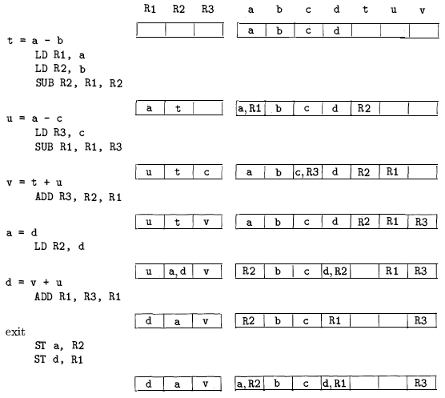
Example

Slide 32
Contd…
Design of the Function getReg(I)
Consider instruction x = y + z. First, we must pick a register for y and a register for z. The rules are as follows:
1 . If y is currently in a register, pick a register already containing y as Ry. Do not issue a machine instruction to load this register, as none is needed.
2. If y is not in a register, but there is a register that is currently empty, pick one such register as Ry.
3. The difficult case occurs when y is not in a register, and there is no register that is currently empty. We need to pick one of the allowable registers anyway, and we need to make it safe to reuse.

Slide 33
Contd…
Possibilities for the values of R
(a) If the address descriptor for v says that v is somewhere besides R, then we are OK.
(b) If v is x, the value being computed by instruction I, and x is not also one of the other operands of instruction I (z in this example) , then we are OK. The reason is that in this case, we know this value of x is never again going to be used, so we are free to ignore it.
( c) Otherwise, if v is not used later (that is , after the instruction I, there are no further uses of v, and if v is live on exit from the block, then v is recomputed within the block) , then we are OK.
(d) If we are not OK by one of the first two cases, then we need to generate the store instruction 8T v, R to place a copy of v in its own memory location. This operation is called a spill.

Slide 34
Contd…
Selection of the register Rx
1. Since a new value of x is being computed, a register that holds only x is always an acceptable choice for Rx; . This statement holds even if x is one of y and z, since our machine instructions allows two registers to be the same in one instruction.
2. If y is not used aft er instruction I, in the sense described for variable v in item (3c) , and Ry holds only y after being loaded, if necessary, then Ry can also be used as Rx; . A similar option holds regarding z and Rz.

Slide 35
End of Ch8…
Thank You
?

